Slide 1



Prion Diseases
Presentation, Epidemiology, Guidance and Management
Welcome to this module on Prion Disease. These are a group of rare progressive neurodegenerative diseases that can affect both humans and animals.

Slide 2
Overview
How to Use this Module?
Learning Outcomes
Prion Disease
  Overview
  Normal Prion Protein
  Abnormal Prion Protein
  Infective Process
  Host Responses
  Codon 129 Polymorphisms
  Epidemiology
  Overview Quiz

Slide 3
Overview
Creutzfeldt-Jakob Disease (CJD)
  Sporadic Creutzfeldt-Jakob Disease (sCJD)
    Epidemiology and Recognition
  Variant Creutzfeldt-Jakob Disease (vCJD)
    Epidemiology and Recognition
  Iatrogenic Creutzfeldt-Jakob Disease (iCJD)
    Epidemiology and Recognition
  sCJD vs vCJD
  Guidance
  Patient Classifications
  Management
  Notification
  The Future

Slide 4
Overview
Genetic Forms of Creutzfeldt-Jakob Disease (CJD)
  Familial Creutzfeldt-Jakob Disease (fCJD)
  Gerstmann-Straussler-Scheinker Syndrome
    Epidemiology, Symptoms and Management
  Fatal Familial Insomnia → Epidemiology, Symptoms and Management
  CJD Quiz
Other Human Prion Diseases
  Kuru → Epidemiology, Symptoms and Management
Zoonotic Prion Diseases
  Bovine Spongiform Encephalopathy (BSE)
  Scrapie
  Quiz

Slide 5
Overview
Summary
What you should have Learned
Recommended Reading
Summary Quiz
References
Image Credits
Quiz Answers

Slide 6
How to Use This Module
I suggest you start by looking at the learning outcomes on the next page. Try to bear these in mind whilst continuing through the rest of the SDL.
Answer the questions and note down your answers in the workbook provided.
Key terms will be highlighted.
Award yourself marks based on your answers. One mark for each correct answer.
  Click on the answer you think is correct on the slide.
  The correct answer will take you to an information slide on why the answer is correct.
Repeat the module until you have managed to attain a mark of greater than 80% (20/25).
Any issues that you are not confident with after completing the module, take the time to read up on them in textbooks or use the online resources provided at the end of the module. Have a discussion amongst your peers to ensure understanding.
Enjoy your learning. I hope that this module will give you an insight into Prion diseases.

Slide 7
Learning Outcomes
By the end of this module, you should be able to:
Describe prion diseases and the risk factors associated with them
Describe the transmission process of prion disease
Describe the epidemiology of prion disease
Provide an overview of the signs and symptoms of the prion diseases
Be able to understand the investigations and management of prion disease
Give an overview of the current treatment and prognosis of prion diseases
Understand the infection control protocols involved in the management of prion disease
Be able to provide an overview of the notification procedures in place for prion diseases

Slide 8
Prion Diseases

Slide 9
Overview
1,2,13,14,15
Otherwise known as Transmissible Spongiform Encephalopathies (TSEs)
Rare progressive neurodegenerative disorders primarily affecting the central nervous system
Can occur in one of three main methods:
  Sporadic → occur spontaneously
  Familial → transmitted through genetics and inherited from parents
  Acquired → transmitted from another source
Neuronal loss caused by the abnormal folding of normal prion proteins in the brain
  In part from the toxic build up of abnormal prion proteins
Can affect both humans and animals
Are universally fatal
The function of normal prion proteins is still not well understood
Recognised by veterinarians since the early 1700s but only recognised in humans since the early 1900s

Slide 10
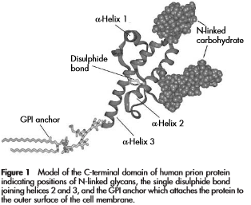
Normal Prion Proteins
2,8,10
Name derived from Proteinaceous infective particle → short hand is PrP^{C}
Present in large amounts in the brain and to lesser amounts in other tissues
Tethered to the outer membrane of neurons
209 amino acids long
Rich in alpha helical structures (Figure →)
Functions relatively unknown
Thought to have a role in:
  Iron Metabolism
  Cell development
  Cell signalling
Similar structure across humans and domesticated animal species
Collinge (2005)

Slide 11
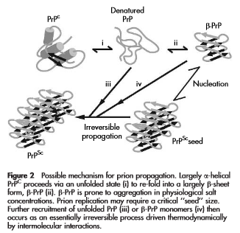
Abnormal Prion Protein
2,8,10
Epigenetic Agent
Rich in Beta Sheets not alpha helixes
Found within vesicles within the cell & lysosomes
Mainly formed from mis-folded PrP^{C} monomers
  PRNP gene mutations are thought to be involved
Typically given the acronym PrP^{SC}
Once stable structure formed more monomers can be recruited
Leads to an explosive autocatalytic formation of abnormal protein → presentation of disease
Distinct diseases caused by similar proteins despite the lack of genetic material → remarkable
Collinge (2005)

Slide 12
Infective Process
2,3,8,10
The abnormal isoforms of the prion protein can be transmitted in many different ways:
  Blood / hormone products
  Eating affected meat
  Transplantation of affected material
  Contaminated surgical implements
  Inherited
  Random spontaneous mutations → Similar to Dr Jekyll and Mr Hyde → good protein / bad protein
The infectious particle is made from protein but does not contain any nucleic acid
  Cannot divide in the same way as other infectious pathogens
Accumulation of the abnormal protein (or fragments of it) occurs in both neurons and non-neuronal cells
  Protein is usually a conformational isoform of a normal host prion protein → amino acid structure the same
In neurons the build up causes apoptosis and degeneration of the affected neurons
Symptoms are neuronal as they are thought to be the main location of PrP conversion & replication

Slide 13
Host Response
2,3,8,10
As the infectious particle is a mutated host protein the host has a limited response to it
  Partly assumed to be due to tolerance to PrP^{SC}
  May be partly due to the fact that PrP^{C} is involved in the immune response
Exact role of the immune response in the development of prion disease is unclear
PrP^{SC} is unable to be broken down by proteases and is insoluble
Activation of the lymphoreticular system (LRS) is observed in humans
  Build-up of PrP^{SC} is observed in the spleen before any CNS involvement is found in variant CJD
  However build up is not observed in sporadic CJD
Presence of PrP^{SC} in neurons leads to activation of the glial cells

Slide 14
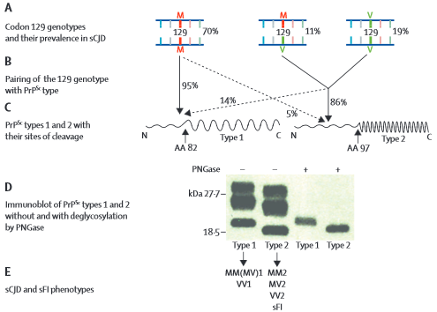
Codon 129 Polymorphism and CJD
8
Rates of sCJD in people with one of the variances of codon 129 have been shown to be higher than those observed in patients without the variance
Section A shows the mutations and prevalence in sCJD
Section B shows the relationship of the mutations to the forms of CJD
Section C shows the variance in the N-terminal domain of abnormal Prion Protein that the mutations link to
Section D shows the different proteins
Section E shows the phenotype of each of the strains of sCJD
Puoti et al (2012)

Slide 15
Epidemiology
1,2,13,14,15
Prion Diseases are rare
Difficult to estimate the prevalence because of the challenges in diagnosing the conditions
Estimates of their prevalence vary between the conditions
The range goes from 1 in a million per year to 1 in 100 million per year
  The average annual prevalence is estimated to be between 1 and 2 cases per million
Animal conditions are more prevalent and there have been large outbreaks
  Most famous of these is the BSE epidemic in the UK (peak years from 1981-1996)
Estimation of the prevalence of conditions affecting wild animals is understandably difficult

Slide 16
Overview Quiz

Slide 17
Question 1
Prion disease are able to replicate in a host despite the fact they do not have any replicative material?
TRUE
NOT ENOUGH EVIDENCE
FALSE

Slide 18
Question 2
Prion diseases are one of the few diseases that are known that are able to be transmitted from animals to humans and cause infection without the need for a vector?
TRUE
NOT ENOUGH EVIDENCE
FALSE

Slide 19
Question 3
The progressive neurological nature of the disorders is due to the build up of toxic levels of the abnormal protein in neurons which leads to apoptosis and the degeneration of the affected neurons?
TRUE
NOT ENOUGH EVIDENCE
FALSE

Slide 20
Question 4
The immune system is thought to play an important role in the disease causing process of prion diseases, particularly in the effects of inflammation on the tissues surrounding affect neurons.
TRUE
NOT ENOUGH EVIDENCE
FALSE

Slide 21
Question 5
The normal prion protein has a different structure in different species despite the fact that abnormal conformational isomers of it can cause infections in both humans and animals?
TRUE
NOT ENOUGH EVIDENCE
FALSE

Slide 22
Creutzfeldt-Jakob Disease (CJD)
Most widely known prion disease of humans

Slide 23
Creutzfeldt-Jakob Disease (CJD)
1,2,13,14,15
Most well known and common prion disease affecting humans
Occurs worldwide and is very heterogenetic due to the nature of the mutations involved
Comes in multiple forms:
  Sporadic → ‘classic CJD’ → related to developing mutations in the prion protein gene
  Variant → related to infection with BSE
  Iatrogenic → related to infection from contaminated medical products / equipment
  Genetic → related to inherited mutations of the prion protein gene
Recognised since the early 1920s although the causative mechanism wasn’t defined until the 1980s
Characterised by ‘spongiform degeneration’ of neural tissue caused by microscopic vacuolisation
Usually present with rapidly progressing dementia, behavioural abnormalities and myoclonus
Always fatal → usually within 1 year of the disease manifesting itself

Slide 24
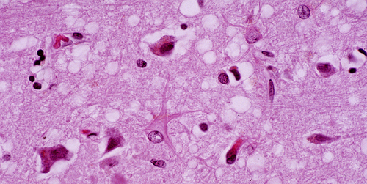
Spongiform Degeneration
Spongiform changes observed in a CJD patients brain
Agamanolis, D.P (2009)

Slide 25
Sporadic Creutzfeldt-Jakob Disease (sCJD)
1,2,13,14,15
Not related to infection by BSE
Most common type → causes around 80-95% of CJD observed
Exact mechanism of the conformation change from normal protein to abnormal prion protein has yet to be determined
5 subtypes → differ in clinical presentation and pathological changes observed in the brain
  Different mutation locations on the gene encoding for normal prion protein → very heterogeneous
Risk of occurrence increases with age with the median age of death around 68 years
  Average age of presentation is around 60-65 years with average survival between 4 and 5 months after onset
Characterised by spongiform changes and neuronal loss in the 3rd and 4th cortical layers
  No inflammation observed but there is a build up of PrP^{SC}
The only risk factor identified other than genetics (cause genetic forms of sCJD)
  Mutation leading to homozygous methionine (MM) or valine at codon 129 in normal prion protein occurs in around 37% of the population

Slide 26
Epidemiology
1,2,11,13,14,15
Although the most common variation of CJD sCJD is still relatively uncommon
Annual incidence rates for sCJD are around 1 cases per million per year worldwide
  Rates over up to 2 cases per million per year are observed in some countries
However this rate increases to around 3.5 cases per million per year in over 50s
There have been 62 cases of sCJD confirmed in the UK so far in 2013
Detection is difficult therefore the estimation of the prevalence rate is understandably difficult
There is a very low chance of sCJD being transmitted from person to person in the same way that vCJD is transmitted with the only evidence of transmission being observed in the use of growth hormone from the pituitary of undiagnosed deceased CJD sufferers
However the precautions should remain the same for all the forms of CJD
Some person to person transmission has been observed with the transplantation of brain tissue or hormones of affected individuals into unaffected donors

Slide 27
Recognition and Diagnosis (sCJD)
Definite
Confirmed with neuropathology or immunocytochemistry
Rapidly Progressive Dementia
A: Myoclonus
B: Visual or Cerebellar Problems
C: Pyramidal or Extrapyramidal Features
D: Akinetic Mutism
Typical EEG → periodic synchronous bi-phasic or tri-phasic sharp wave complexes
High Signal in Caudate / Putamen on T2 weighted MRI Brain Scan
Presence of 14-3-3 protein in CSF
Probable
1 + 2 of 2 + 3
OR
1 + 2 of 2 + 4
Possible
1 + 2 of 2
Duration of more than 2 years
The National CJD Research and Surveillance Unit (NCJDRSU) (2010)

Slide 28
Variant Creutzfeldt-Jakob Disease (vCJD)
1,2,4,9,13,14,15
Related to infection with Bovine Spongiform Encephalitis
  Link between BSE and vCJD was first identified in 1996
Caused around 10% of observed cases in the UK since 1990
Symptoms can occur after any period of time after infection as the incubation period is unclear
  There is still the possibility that people who were infected during the BSE outbreak could present with vCJD
Characterised by florid or clusters of amyloid plaques of PrP^{SC} across the cerebrum, cerebellum with lower levels observed in the basal ganglia and thalamus
Transmission is much more readily achieved than in sCJD → has been transmitted via:
  Infected meat products
  Contaminated medical or surgical products
  Only confirmed transmission has been through blood transfusion of non leucodepleted red blood cells
Average age of infection and death is much younger than in sCJD → around 28 years
  Although it has been detected in a variety of ages from the youngest at age 11 to the oldest at age 74
  Average survival time from the onset of the disease is around 14 months

Slide 29
Epidemiology
1,2,4,9,13,14,15
Despite the widespread diagnosis of cattle with bovine spongiform encephalitis (BSE)
  Peak numbers were 36,000 BSE cases in the UK in 1992
  However this means that the exposure is likely much greater in the UK than elsewhere
Numbers of human cases have been relatively low with only 228 recognised cases worldwide
  177 of those cases were detected in the UK and only 1 in the past 2 years
As with sCJD the estimation of the prevalence rate is difficult because of the lack of a blood test or other easier method for diagnosis
The disposal of materials that have been in contact with vCJD patients is therefore imperative
Using tissue analysis of tonsils and appendices research groups have estimated there to be a prevalence of 1 in 2000 although it is unclear if all of these will progress to develop vCJD
However all the vCJD cases so far identified have had existing mutations in the normal prion protein gene therefore this may be a non-specific finding in peripheral lymphoid tissue
  Mutation leading to homozygous methionine (MM) or valine at codon 129 in normal prion protein

Slide 30
Recognition and Diagnosis (vCJD)
Definite
1A + neuropathological confirmation of vCJD
A: Progressive Neuropsychiatric disorder
B: Duration of Illness Less than 6 months
C: Routine investigations have no alternate diagnosis
D: No history of iatrogenic exposure
E: No evidence or family history of familial form of TSE
A: Early psychiatric symptoms
B: Persistent Painful Sensory Symptoms
C: Ataxia
D: Myoclonus or chorea or dystonia
E: Dementia
A: EEG does not show the typical appearance of CJD in the early stages of illness
B: Bilateral pulvinar high signal on MRI
A: Positive tonsil Biopsy
Probable
1 and 4 or 5 of 2 + 3A & 3B
1 and 4 or 5 of 2 + 4A
Possible
1 and 4 or 5 of 2 and 3A
The National CJD Research and Surveillance Unit (NCJDRSU) (2010)

Slide 31
Iatrogenic Creutzfeldt-Jakob Disease (iCJD)
1,2,13,14,15
Related to contaminated medical or surgical products
Involves the accidental transmission of CJD to an unaffected individual without them being in contact directly with material contaminated with BSE / CJD
Typically causes less than 1% of all cases of CJD observed
In the past the most likely route of transmission was through the use of growth hormone extracted from the pituitary gland of deceased individuals who had been affected with CJD
  However now that growth hormone is made synthetically this route of transmission is no longer available
Most cases where the cause is identified are of sCJD but there are some documented cases of vCJD transmission, however these are classed as secondary transmission of vCJD not iCJD
Blood transfusions have also been documented be a route for transmission between people
  Only 5 confirmed cases in the UK → 4 from red blood cells and 1 from plasma products
Contaminated surgical instruments has been postulated as a route of transmission however no definite cases have been identified with this route of transmission

Slide 32
Epidemiology
1,2,13,14,15
Increased awareness of the risks and mechanisms of transmission of vCJD have led to decreased occurrences of iCJD in recent times
The source of the initial infection in the vast majority of cases is unknown
Originally used to describe the transfer of sCJD to unaffected individuals through transfer of brain material from an affected individual
Now covers the transmission of both sCJD and vCJD to unaffected individuals
There were only 5 documented cases of death from confirmed iCJD in the UK in 2012
According to the latest figures there has been one case of death in the UK in 2013

Slide 33
Recognition and Diagnosis (iCJD)
Definite
Confirmed CJD with recognised iatrogenic risk factor
Relevant Risk Factors
Treatment with human pituitary growth hormone or gonadotrophin releasing hormone or human dura mata graft
Corneal graft donor where donor has been classified as having prion disease or probably having prion disease
Exposure to contaminated surgical instruments
List is provisional → other mechanisms may be identified in the future
Probable
Progressive predominant cerebellar dysfunction in recipients of human pituitary growth hormone
Probable CJD with recognised iatrogenic risk factor from the box
The National CJD Research and Surveillance Unit (NCJDRSU) (2010)

Slide 34
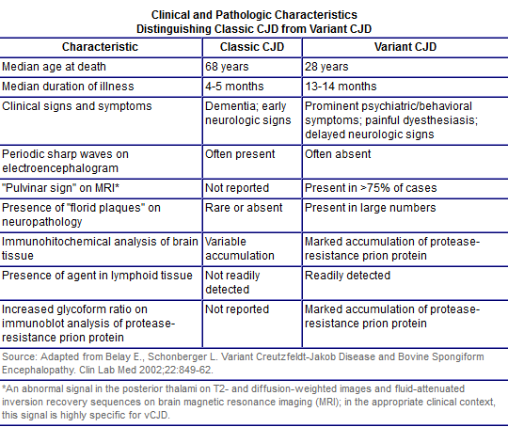
sCJD vs vCJD
CDC Information site on CJD (2013)

Slide 35
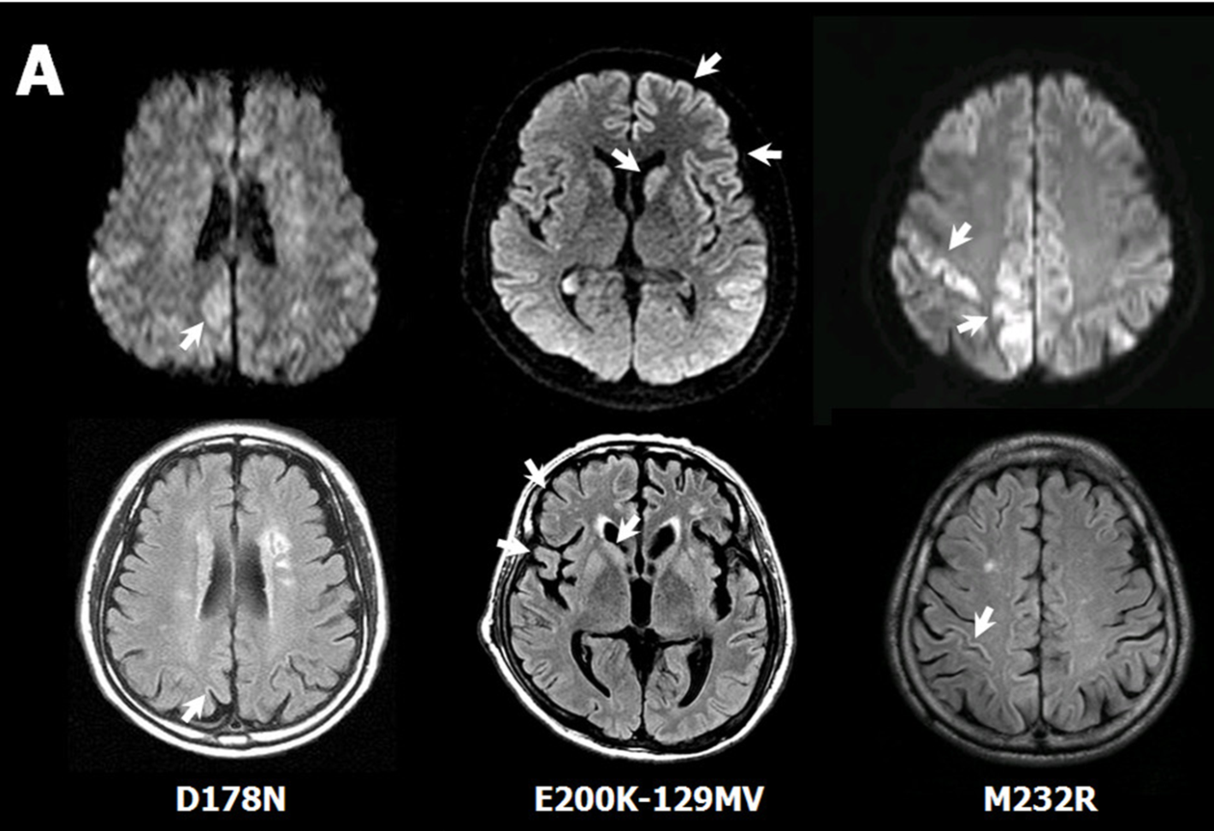
Abnormal MRI
3 MRI’s of probable fCJD patients who have polymorphisms in the normal prion protein gene (mutations listed)
Top line of MRI’s is done with diffusion weighted imaging
Bottom line is done with T2-FLAIR weighting
White arrows indicate lesions of the brain
Case 1 Case 2 Case 3
Choi et al (2009)

Slide 36
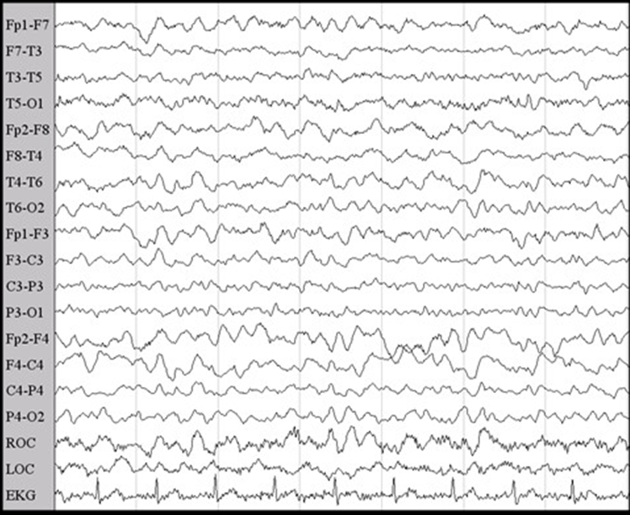
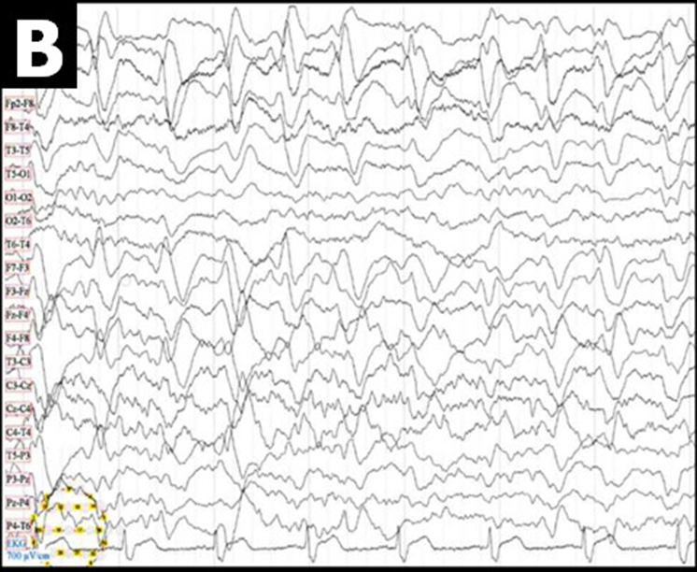
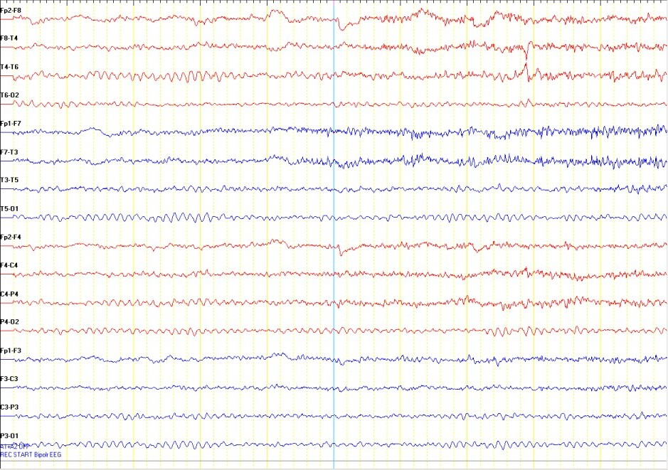
Abnormal EEG
EEG’s from previous 3 cases that were shown on MRI
Case 1 had a normal EEG
Case 2 and 3 have abnormal EEG’s
Observe the periodic sharp abnormal waveforms across all readings
Buster’s Blog (2012)
Normal EEG (as seen in Case 1)
Choi et al (2009)
Case 2
Choi et al (2009)
Case 3
Choi et al (2009)

Slide 37
Management
No proven treatment for any type of CJD
The management of each of the types is the same
Studies have been underway for some time to try to find a possible treatment without success so far
Management involves palliative care for the patient to ensure they are comfortable
  Reducing pain through use of analgesia and the management of the psychological symptoms
In the UK the patient is referred to the National Care Team for CJD for diagnosis and management
It is recommended that patients diagnosed with CJD create an advanced directive whilst they maintain capacity to ensure that their expressed wishes are followed through when they lose the capacity. These include:
  Donation of organs for research (brain in particular)
  Medications they wish to take
  Use of nasogastric tubes if required
  Use of mechanical ventilation if required
The National CJD Research and Surveillance Unit (NCJDRSU) (2013)
TSE Risk Assessment Sub Group (2013)

Slide 38
Guidance
Since the confirmed link between vCJD and BSE careful management & guidance has been implemented by the Department of Health in the UK in 2003 and refined annually
The aim of the guidance is to prevent the transmission of all forms of CJD and prion disease
There is a dedicated ‘key worker’ assigned to each case who is there to coordinate the care of the patient and to provide support in terms of information and advice.
GPs are recommended to be the ‘clinical guardian’ and be in continual link with consultant neurologists and the 2 specialist centres for CJD
  National CJD Surveillance Unit and the National Prion Clinic
A key part of the guidance is the classification of the patients into group dependent on their infective state and risk factors toward developing infection
The National CJD Research and Surveillance Unit (NCJDRSU) (2013)
TSE Risk Assessment Sub Group (2013)

Slide 39
Patient Classification
Symptomatic
Patients that meet the diagnostic criteria for CJD / vCJD
Can be definite, probable or possible cases
Cases of neurological disease of unknown origin are included as well until confirmed diagnosis
TSE Risk Assessment Sub Group (2013)

Slide 40
Patient Classification
At Increased Risk of Genetic CJD
Patients who are asymptomatic but are perceived to be at an increased risk of CJD due to:
Family History
  Or shown via other methods → specific genetic testing
  Blood relative known to have a genetic mutation that increases the susceptibility of CJD
  Have had 2 or more blood relatives with confirmed CJD
  Discussed in a separate section
TSE Risk Assessment Sub Group (2013)

Slide 41
Patient Classification
At Increased Risk of vCJD
Patients who are asymptomatic but are perceived to be at an increased risk of CJD due to:
Contact with contaminated blood products for a patient who went on to develop vCJD
  Full donation of blood products
  Non leucodepleted red blood cells
  Platelets
  From 300 or more donors
TSE Risk Assessment Sub Group (2013)

Slide 42
Patient Classification
At Increased Risk of CJD through Iatrogenic Exposures
Patients who are asymptomatic but are perceived to be at an increased risk of CJD due to:
Received growth hormone or Gonadotropin Releasing hormone from human pituitary glands
  Discontinued in the UK in 1973 (GnRH) and 1985 (GH)
  May have continued in other countries after this date so check during history
Have had intradural brain or spinal surgery before August 1992
  Or have / might have been the recipient of human derived dura mater
  Have had surgery with implements that might have been contaminated by use on a patient who went on to develop CJD / vCJD or was at increased risk of the conditions
  Have had blood transfusions which have been identified as being from more than 300 donors since January 1990 or have given blood to someone who went on to develop CJD
  Have been treated with certain UK sourced plasma products between 1990 and 2001
TSE Risk Assessment Sub Group (2013)

Slide 43
Management of the Classifications
In hospital does not need to be any different from other patients with neurological conditions
  Management can be done on an open ward and isolation is not required
  Standard infection control procedures should be followed
Management in the community should not be avoided particularly in the early stages of the disease as long as standard infection control procedures are followed
  There is no risk of direct transmission of the disease so regular contact with family and friends is recommended to maintain psychological health
  Routine clinical contact should be maintained to ensure knowledge of the current state of the disease
In symptomatic patients when performing invasive procedures, considerations need to be made with regards to the infectivity of the tissues and precautions taken if required
Procedures should only be carried out by staff who are well trained and aware of the risks of involved with the tasks
TSE Risk Assessment Sub Group (2013)

Slide 44
Management of Tissues
High Risk Tissues
Brain, Spinal Cord, Cranial Nerves (in particular the whole optic nerve), Cranial Ganglia, Posterior of the eye and the pituitary Gland
Medium Risk Tissues
Spinal ganglia, olfactory epithelium
In addition if vCJD: Tonsils, appendix, thymus, spleen, adrenal gland, lymph nodes and gut associated lymphoid tissues
Low Risk Tissues
All other tissues including: blood, saliva, CSF and bodily excretions
Blood only high risk if transfused in large volumes from vCJD patients
Dura mater unless implanted prior to 1992 → high risk as are the instruments used to perform the operation
TSE Risk Assessment Sub Group (2013)

Slide 45
Management of Tissues
High Risk Tissues → whether definite, probable, possible or at increased risk of CJD
Single use equipment
Destroy after use
Alternatively: quarantine and re-use exclusively on that patient
Medium Risk Tissues → whether definite, probable, possible or at increased risk of CJD
Single use equipment
Destroy after use
Alternatively: quarantine and re-use exclusively on that patient
Low Risk Tissues → whether definite, probable, possible or at increased risk of CJD
No special precautions required
Normal procedures should be followed
TSE Risk Assessment Sub Group (2013)

Slide 46
Management of Clinical Waste
High or Medium Risk Tissues → whether definite, probable, possible or at increased risk of CJD
INCINERATE
Low Risk Tissues → whether definite, probable, possible or at increased risk of CJD
No special precautions required
Normal procedures for disposal of clinical waste should be followed
This includes management of bed linen whether used or fouled by bodily excretions or fluids
TSE Risk Assessment Sub Group (2013)

Slide 47
Notification
All cases of suspected CJD or other prion diseases are to be reported by clinicians to both the National Prion Centre in London and the National CJD Research and Surveillance Unit in Edinburgh
Refer to the National Care Team for CJD for diagnosis and management
So far in 2013 there have been 110 referrals for suspected CJD in the UK with the total number confirmed to have had CJD being 68 (data correct as of November 4th 2013)
Since 1990 there have been 3126 referrals to the centres with 1860 those confirmed to have a form of CJD or have died from a form of CJD
Both centres are available if clinicians wish to discuss cases before making a decision on reporting them
In addition all suspected cases should be reported to the local public health team
  Allows for local management of any risk to the public
The National CJD Research and Surveillance Unit (NCJDRSU) (2013)

Slide 48
The Future
There have been at least 4 studies which have looked at the impact that the use of various drugs have for improving the outcomes of prion disease
  The drugs tried are: Quinacrine, Pentosan Polysulphate, Flupirtine and Doxycycline
None of the drugs have shown significant benefit in stopping the progression of prion disease
Identification of potential targets is difficult and is currently based on chance observation or theoretical considerations
In addition the difficulties of not understanding the disease process in detail is hampering efforts to discover possible therapeutic agents
  The therapeutic effect of drugs in animals in many cases does not translate effectively to humans
  The challenges of creating a human trial are also prolonging the efforts to find effective therapeutic agents
The late diagnosis of most cases of prion disease also does not help the possibility of finding a successful therapeutic agent and may reduce the effect of many of the possible therapeutic agents
The National CJD Research and Surveillance Unit (NCJDRSU) (2012)

Slide 49
Genetic Forms of Creutzfeldt-Jakob Disease (CJD)
Very rare forms of CJD from inherited mutations in the prion protein gene

Slide 50
Genetic Forms of Creutzfeldt-Jakob Disease
1,2,11,13,14,15
Caused by inherited mutations of the human normal prion protein gene
Account for around 10-15% of observed cases of CJD and similar Prion diseases
Many different mutations can cause disease → at least 55 identified so far → each with their own clinical picture
  E.g. age at onset of disease, rapidity of progression of disease and particular symptoms
The diseases are not transmissible in any way and are not related to contact with BSE
Confirmation of the diagnosis is made through a blood test which analyses the genes to determine if there is any genetic abnormality in the normal prion protein gene
The conditions are very rare as the are a subset of the already rare prevalence of CJD
  There have been 4 confirmed cases of genetic CJD in the UK in 2013 so far
The National CJD Research and Surveillance Unit (NCJDRSU) (2013)

Slide 51
Familial Creutzfeldt-Jakob Disease (fCJD)
1,2,11,13,14,15
Familial CJD is very similar to sporadic CJD
However can present very variably → mimic Alzheimer’s Disease in presentation
  Or other neurodegenerative conditions
Autosomal Dominant with high penetrance
Mutation which changes the conformation of the normal prion protein
  From PrP^{C} to PrP^{SC}
Promote the development of abnormal prion protein and therefore disease

Slide 52
Gerstmann-Straussler-Scheinker Syndrome (GSS)
1,2,11,13,14,15
Autosomal dominant with almost complete penetrance
Mutation in the Normal Prion Protein gene → P102L classically → proline for leucine at codon 102
  Other mutations that confer susceptibility include: Point mutations, premature stop codons and the number of octapeptide repeats in the N-terminal domain
First recognised in a North of England family in the 1970’s as a strange neurodegenerative disease
Originally thought to be an strange form of Huntingdon’s disease until one of the family members presented with classical sCJD
Onset is normally between the 5th and 7th decades of life
Commonly presents with progressive cerebral ataxia with lower limb weakness and areflexia
  Signs of cerebellar dysfunction are almost always present at some point during the course of the disease
Most present with an amyloidopathy → deposits of amyloid in the brain → similar to Alzheimer’s Disease
Cognitive impairment becomes more pronounced as the condition progresses
Survival time from onset of the disease is between 5 and 7 years

Slide 53
Epidemiology
1,2,11,13,14,15
Can present with no previous family history of the disease
Rare → prevalence estimated to be between 1 in 10 million and 1 in 100 million per year

Slide 54
Fatal Familial Insomnia (FFI)
1,2,11,13,14,15
Autosomal Dominant with a high penetrance
Mutation in Normal Prion Protein Gene → typically D178N →Asparagine for aspartic acid at codon 178
First recognised in Italian families in the late 1980’s but derivatives now observed all over the world
Disease has an earlier onset and shorter duration in patients who are homozygous for methionine at codon 129 of the normal protein gene and they are more likely to have hallucinations and myoclonus
Classical neuronal changes observed on MRI and EEG with CJD are not observed in FFI with scans typically appearing normal. In addition there is no rise in the levels of 14-3-3 protein in the CSF
Spongiform degeneration is rarely observed although both neuronal loss and gliosis occur mainly within the thalamus, cerebellum and the olivary bodies
Characterised by a progressive development of insomnia and loss of the normal circadian rhythm
  Can present with confusion during waking hours due to lack of sleep in addition to inattention and impaired memory and concentration
  Methionine heterozygous patients develop signs of ataxia, nystagmus and bulbar signs
  Development of dementia is rare

Slide 55
Epidemiology
1,2,11,13,14,15
Can be detected in families with no previous signs of the disease
Prevalence is so rare a definite rate has not been described although there are families in which the disease is commonly present
  Only been 100 cases worldwide diagnosed
  Confined to 40 families
Rates are the same in both males and females

Slide 56
Recognition and Diagnosis
Definite
Definite TSE + Definite or probably TSE in a 1st degree relative
Definite TSE with a known pathogenic mutation of the Normal Prion Protein gene
Probable
Progressive neuropsychiatric disorder + definite or probable TSE in a 1st degree relative
Progressive neuropsychiatric disorder + known pathogenic mutation of the normal prion protein gene
The National CJD Research and Surveillance Unit (NCJDRSU) (2010)

Slide 57
CJD Quiz

Slide 58
Question 1
CJD can be spread in multiple ways and is very difficult to diagnose because of the wide spread of possible symptoms despite the criteria available for diagnosis?
TRUE
NOT ENOUGH EVIDENCE
FALSE

Slide 59
Question 2
Despite all the publicity about variant CJD it is still the most uncommon form of CJD with the majority of cases presenting being of sporadic CJD which is not related to BSE contact?
TRUE
NOT ENOUGH EVIDENCE
FALSE

Slide 60
Question 3
Patients who develop Iatrogenic CJD can only have variant CJD because the other forms cannot be transmitted from person to person?
TRUE
NOT ENOUGH EVIDENCE
FALSE

Slide 61
Question 4
Special precautions need to be taken when taking blood from a patient with variant CJD rather than following the normal guidelines in place for taking blood?
TRUE
NOT ENOUGH EVIDENCE
FALSE

Slide 62
Question 5
Patients who are homozygous for methionine at codon 129 of the normal prion protein gene are more likely to develop CJD if they come into contact with the abnormal protein?
TRUE
NOT ENOUGH EVIDENCE
FALSE

Slide 63
Question 6
What is the likely diagnosis?
69 year male presents with progressive neurodegeneration with rapidly worsening dementia, evidence of myoclonus and cerebellar ataxia. An EEG shows periodic synchronous bi-phasic or tri-phasic sharp wave complexes. There is no family history of note.
sCJD
vCJD
iCJD
GSS
FFI
Other Neurological Condition

Slide 64
Question 7
What is the likely diagnosis?
68 year old male with progressive neurodegeneration. He struggles to perform his daily tasks and needs support. His family report that he is more irritable and can be aggressive at times. On MRI the ventricles are enlarged and there is some evidence of shrinkage of the cerebral cortex.
sCJD
vCJD
iCJD
GSS
FFI
Other Neurological Condition

Slide 65
Question 8
What is the likely diagnosis?
30 year old female has been referred by her family after they have noticed changes in her behaviour with some psychiatric disturbances which have been progressing over the last 4 months. There is no change on the EEG but the MRI shows a “pulvinar sign”.
sCJD
vCJD
iCJD
GSS
FFI
Other Neurological Condition

Slide 66
Question 9
What is the likely diagnosis?
A 45 year female presents with progressive cerebral ataxia and lower limb areflexia with some weakness. There is no evidence of any development of dementia. There are some signs of slowing and abnormal waves on the EEG. Her family report her father developed similar symptoms when he was 46 and unfortunately passed away within a year of their onset.
sCJD
vCJD
iCJD
GSS
FFI
Other Neurological Condition

Slide 67
Question 10
What is the likely diagnosis?
A 57 year male presents with symptoms of progressive tiredness during the day and progressively worsening insomnia at night. He reports that he experiences hallucinations during the day, whilst his partner says he appears like he is in a faraway place and confused. She also reports that his mother developed similar symptoms before her death. All investigations are normal.
sCJD
vCJD
iCJD
GSS
FFI
Other Neurological Condition

Slide 68
Question 11
What is the risk level of the following patient?
32 year old male received 350 blood transfusions because of his haemophilia during the BSE outbreak in the UK and looking at the donors a number of them have gone on to develop vCJD. The patient has no symptoms of neurological disease.
SYMPTOMATIC
INCREASED RISK
NO INCREASED RISK

Slide 69
Question 12
What is the risk level of the following patient?
A 68 year old man presents with progressive neurological symptoms which his partner says have been getting more noticeable over the past couple of years. There has been no diagnosis but there are a number of investigations that have been planned, including an EEG and an MRI of the brain.
SYMPTOMATIC
INCREASED RISK
NO INCREASED RISK

Slide 70
Question 13
What is the risk level of the following patient?
A 40 year female who has had spinal surgery to correct a prolapsed disk in 2005. She has no neurological symptoms and has no family history of neurological disease.
SYMPTOMATIC
INCREASED RISK
NO INCREASED RISK

Slide 71
Question 14
You are a neurologist. A 68 year female presents with neurological symptoms which you think could be CJD. After taking the history and examining her you still think CJD is a possible diagnosis.
What should you do? Select all that apply.
Notify the National Prion Centre and The CJD Surveillance Centre
Arrange MRI
Arrange lumbar puncture
Refer to the National Care Team for CJD
Report to local public health team
Arrange CT Scan

Slide 72
Question 15
You are in A&E. A 72 year old male presents with his wife who says over the last few hours he has become more distant and has lost the ability to speak properly and the left side of his face appears to have drooped.
What should you do? Select all that apply.
Notify the National Prion Centre and The CJD Surveillance Centre
Arrange MRI
Arrange lumbar puncture
Refer to the National Care Team for CJD
Report to local public health team
Arrange CT Scan

Slide 73
Other Human Prion Diseases
Other rarer human prion diseases

Slide 74
Kuru
1,2,11,13,14,15
Historically important
Thought to be extinct now although 11 new cases have been identified between 1994 and 1996
Incubation period unknown for definite but thought to be between 9 and 24 months up to around 50 years with the detection of the recent cases
Was relatively common in Papua New Guinea → last outbreak was in the 1950’s
Endemic in the Fore tribes that practiced cannibalism → practice stopped in the 1950’s
Variable age of onset, typically younger whilst the practice was on-going, age now increasing as the younger generations have not practiced cannibalism
Thought to have originated from one of the cannibalised people having sCJD
No mutations of the Normal Prion Protein gene have been detected although like in CJD the detection rate of a homozygous methionine at codon 129 of the Normal Prion protein gene is raised
Is still studied because of the interest in determining the incubation times and resistance mechanisms in a human population

Slide 75
Zoonotic Prion Diseases
Zoonotic prion Diseases are important because of their close relationship to prion diseases observed in humans. The possibility of their transmission into humans and the expression of disease means it is important to understand their aetiology.

Slide 76
Bovine Spongiform Encephalitis (BSE)
Prion disease of cattle → causes a progressive neurological disorder
Otherwise known as “Mad Cow Disease”
Thought the first probable case was identified in the 1970’s with the first confirmed cases being identified in 1986 → most commonly in animals aged 4-5 years old
It is thought that feeding cattle products derived from meat and bone of other cattle or sheep cause the first infections after in inclusion the products from a sporadically occurring case of BSE in cattle or a case of scrapie in sheep
The continuing of this practice enhanced the spread of the disease among cattle
In total up to 2013 there have been 183,321 cases of BSE in UK cattle herds
Causes spongiform degeneration of the brain and spinal cord similar to that of CJD in humans
  Similar signs → change in behaviour / weakness / repeated exaggerations to sounds / touch
  Affected animals are culled to prevent further transmission
Only animal prion strain with known pathogenicity in humans → causes Variant CJD
DEFRA (2013)

Slide 77
Scrapie
Fatal progressive neurological disease of sheep and goats
First identified over 250 years ago in sheep and has been mostly controlled by breeding programs to select for sheep which have resistance to the disease
Main route of transmission is thought to be through exposure to affected animals and their environment
Evidence has shown it can be transmitted to cattle and cause a form of BSE (and vice versa)
Active monitoring of herds for scrapie is enforce across the EU to minimise the possibility of its appearance in food for human consumption
Any animals found with the condition are culled to remove them from the herd and any risk to humans
DEFRA (2013)

Slide 78
Summary
Prion Disease is still present in the worldwide despite the epidemic of vCJD having passed
The overall annual prevalence worldwide of the conditions is estimated to be 1-2 cases per million although some estimates of vCJD are as low as 1 in 2000
There is still more research required into working out the pathogenic mechanisms of prion disease that could assist in providing possible therapeutic agents for the conditions
In the meantime there are currently no therapeutic agents which assist in prolonging the survival of patients with the condition and they are still universally fatal diseases
The guidance that has been put in place by the UK government has made sure that health practitioners are aware of the conditions, their symptoms and the risk factors in order to keep a close surveillance to ensure better understanding and to minimise the risk of transmission among the population

Slide 79
What You Should Have Learned
You should now be able to:
Describe prion diseases and the risk factors associated with them
Describe the transmission process of prion disease
Describe the epidemiology of prion disease
Provide an overview of the signs and symptoms of the prion diseases
Be able to understand the investigations and management of prion disease
Give an overview of the treatment and prognosis of prion diseases
Understand the infection control protocols involved in the management of prion disease
Be able to provide an overview of the notification procedures in place for prion diseases

Slide 80
Summary Quiz

Slide 81
Question 1
The future for the treatment of prion diseases is bright with many potential therapeutic agents in clinical trials and about to be released to the market?
TRUE
NOT ENOUGH EVIDENCE
FALSE

Slide 82
Question 2
In the UK all suspected cases of CJD are referred to both the National Prion Centre in London and the National CJD Surveillance Centre in Edinburgh with the diagnosis and management being coordinated by the National Care Team for CJD?
TRUE
NOT ENOUGH EVIDENCE
FALSE

Slide 83
Question 3
Bovine Spongiform Encephalitis (BSE) was most prevalent in the UK between 1986 and 1996. The large number of cases of BSE in the UK has resulted in some predictions of the prevalence of vCJD as low as 1 in 2000, despite the sporadic nature of the cases so far.
TRUE
NOT ENOUGH EVIDENCE
FALSE

Slide 84
Question 4
There is no difference between the management of the disposal of high and medium risk tissues of CJD patients to that of tissues with a low risk of CJD.
TRUE
NOT ENOUGH EVIDENCE
FALSE

Slide 85
Question 5
The prognosis of prion disease patients is not good, in part because of the late diagnosis time. The delay of the diagnosis not only worsens the projections for the patient but also hampers efforts at finding effective therapeutic agents for the treatment of prion disease.
TRUE
NOT ENOUGH EVIDENCE
FALSE

Slide 86
Recommended Reading
“Guidance on the Minimisation the risk of transmission of CJD / vCJD in healthcare settings” Department of Health and the Advisory Committee on Dangerous Pathogens' Transmissible Spongiform Encephalopathy (ACDP TSE) Risk Management Subgroup (2013)
https://www.gov.uk/government/publications/guidance-from-the-acdp-tse-risk- management-subgroup-formerly-tse-working-group
NHS Choices Information Site on CJD (2013)
http://www.nhs.uk/Conditions/Creutzfeldt-Jakob-disease/Pages/Introduction.aspx
CDC Information Site on Prion Disease (2013)
http://www.cdc.gov/ncidod/dvrd/prions/index.htm
The National CJD Research and Surveillance Unit (NCJDRSU)
www.cjd.ed.ac.uk
The National Prion Clinic (NPC)
www.prion.ucl.ac.uk

Slide 87
References
ARAUJO, A. Q. Prionic diseases. Arq Neuropsiquiatr, v. 71, n. 9b, p. 731-7, Sep 2013. ISSN 0004-282x.
COLLINGE, J. Molecular neurology of prion disease. J Neurol Neurosurg Psychiatry, v. 76, n. 7, p. 906-19, Jul 2005. ISSN 0022-3050 (Print) 0022-3050.
FORLONI, G. The contribution of the immune system to prion diseases. Drug Discovery Today: Disease Mechanisms, v. 1, n. 3, p. 351 - 356, 2004. ISSN 1740-6765. Disponível em: < http://www.sciencedirect.com/science/article/pii/S1740676504000549 >.
GILL, O. N. et al. Prevalent abnormal prion protein in human appendixes after bovine spongiform encephalopathy epizootic: large scale survey. BMJ, v. 347, p. f5675, 2013. ISSN 0959-535x.
HEAD, M. W. Human prion diseases: molecular, cellular and population biology. Neuropathology, v. 33, n. 3, p. 221-36, Jun 2013. ISSN 0919-6544.
IMRAN, M.; MAHMOOD, S. An overview of human prion diseases. Virol J, v. 8, p. 559, 2011. ISSN 1743-422x.
ORTEGA-CUBERO, S. et al. Structural and functional neuroimaging in human prion diseases. Neurologia, v. 28, n. 5, p. 299-308, Jun 2013. ISSN 0213-4853.
PUOTI, G. et al. Sporadic human prion diseases: molecular insights and diagnosis. Lancet Neurol, v. 11, n. 7, p. 618-28, Jul 2012. ISSN 1474-4422.
SALMON, R. How widespread is variant Creutzfeldt-Jakob disease? BMJ, v. 347, p. f5994, 2013. ISSN 0959-535x.
SISKOVA, Z. How structure shapes (dys)function: A perspective to understanding brain region-specific degeneration in prion disease. In: (Ed.). Prion, v.7, 2013. p.291-293. ISBN 1933-690X (Electronic) 1933-6896

Slide 88
References
Department of Health, Transmissible Spongiform Encephalopathy (TSE) Risk Assessment Subgroup (2013) “Guidance on how to Minimise transmission risk of CJD and vCJD in healthcare settings” Main section used was part 4 “Infection control of CJD, vCJD and other human prion diseases in healthcare and community settings” Last Accessed 10/11/13
https://www.gov.uk/government/publications/guidance-from-the-acdp-tse-risk- management-subgroup-formerly-tse-working-group
The National Prion Unit (NPU) (2013). Last Accessed 10/11/13
http://www.prion.ucl.ac.uk/welcome/
The National CJD Research and Surveillance Unit (NCJDRSU) (2013) “Diagnosis and Testing” + “Surveillance” + “Research”
Last Accessed 10/11/13
http://www.cjd.ed.ac.uk/index.html
Centre for Disease Control and Prevention (CDC), December 2012, “Information Page on Prion Diseases” Last Accessed 10/11/13
http://www.cdc.gov/ncidod/dvrd/prions/index.htm
NHS Choices, October 2013, “Information Page on CJD”. Last Accessed 10/11/13
http://www.nhs.uk/Conditions/Creutzfeldt-Jakob-disease/Pages/Introduction.aspx

Slide 89
References
Department for Environment, Food and Rural Affairs (DEFRA) (2013), “Information page on BSE”. Last accessed 10/11/13
http://www.defra.gov.uk/ahvla-en/disease-control/notifiable/bse/
Department for Environment, Food and Rural Affairs (DEFRA) (2013), “Information page on Scrapie”. Last accessed 10/11/13
http://www.defra.gov.uk/ahvla-en/disease-control/notifiable/scrapie/
Department for Environment, Food and Rural Affairs (DEFRA) (2013), “General Statistics of BSE cases in Great Britain”. Last accessed 10/11/13
http://www.defra.gov.uk/ahvla-en/files/pub-tse-stats-gen.pdf

Slide 90
Image Credits
Normal Prion Protein (Slide Number: 10) → COLLINGE, J. Molecular neurology of prion disease. J Neurol Neurosurg Psychiatry, v. 76, n. 7, p. 906-19, Jul 2005. ISSN 0022-3050 (Print) 0022-3050
Abnormal Prion Protein (Slide Number: 11) → COLLINGE, J. Molecular neurology of prion disease. J Neurol Neurosurg Psychiatry, v. 76, n. 7, p. 906-19, Jul 2005. ISSN 0022-3050 (Print) 0022-3050
Codon 129 Polymorphisms (Slide Number: 14) → PUOTI, G. et al. Sporadic human prion diseases: molecular insights and diagnosis. Lancet Neurol, v. 11, n. 7, p. 618-28, Jul 2012. ISSN 1474-4422
Spongiform Degeneration (Slide Number: 24) → Agamanolis, D.M, Neuropathology, Chapter 5 Infections of the Nervous system” Prion Diseases subsection, NEOMED, Last Accessed 13/11/13 http://neuropathology-web.org/chapter5/chapter5ePrions.html
MRI’s (Slide Number: 35) → CHOI, B. Y. et al. Mutations at codons 178, 200-129, and 232 contributed to the inherited prion diseases in Korean patients. BMC Infect Dis, v. 9, p. 132, 2009. ISSN 1471-2334.
Abnormal EEG’s (Slide Number: 36) → CHOI, B. Y. et al. Mutations at codons 178, 200-129, and 232 contributed to the inherited prion diseases in Korean patients. BMC Infect Dis, v. 9, p. 132, 2009. ISSN 1471-2334.
Normal EEG (Slide Number: 36) → “Will’s Journey in Pictures” 2012, Buster’s Blog. http://busterbeans.blogspot.co.uk/2012/09/wills-journey-in-pictures.html Last Accessed 13/11/13
Image link: http://1.bp.blogspot.com/-VLu2wnEllrw/UEiNXXBJhjI/AAAAAAAAAM4/Ev3STOKNGhw/s1600/Normal+EEG.jpg

Slide 91
Quiz Answers

Slide 92
Question 1
Prion disease are able to replicate in a host despite the fact they do not have any replicative material?
Prion diseases are able to replicate through an unknown mechanism that does not involve genetic code. It seems the protein mis-folding of the normal prion protein gene observed in prion diseases is able to transfer nearby proteins into the abnormal form.
TRUE
Return to Question

Slide 93
Question 2
Prion Diseases are one of the few diseases that are known that are able to be transmitted from animals to humans and cause infection without the need for a vector?
Prion diseases are able to be transferred directly from animals to humans through various vectors and can cause similar infections in both.
TRUE
Return to Question

Slide 94
Question 3
The progressive neurological nature of the disorders is due to the build up of toxic levels of the abnormal protein in neurons which leads to apoptosis and the degeneration of the affected neurons?
This is the current understanding of the biological mode of infection of prion diseases. Further research in need to complete the picture and determine exactly the method of replication of the conditions.
TRUE
Return to Question

Slide 95
Question 4
The immune system is thought to play an important role in the disease causing process of prion diseases, particularly in the effects of inflammation on the tissues surrounding affected neurons.
The role of the immune system has yet to be fully determined in prion disease. Inflammation is known not to be a factor in the disease causing process. However the presence of abnormal prion protein in peripheral lymphoid cells in variant CJD indicates that there is the possibility of some role for the immune system.
NOT ENOUGH EVIDENCE
Return to Question

Slide 96
Question 5
The normal prion protein has a different structure in different species despite the fact that abnormal conformational isomers of it can cause infections in both humans and animals?
The structure of normal prion protein in the same in both animals and humans and the similarity probably has a role in its ability to infect both animals and humans when in its abnormal forms.
FALSE
Return to Question

Slide 97
Question 1
CJD can be spread in multiple ways and is very difficult to diagnose because of the wide spread of possible symptoms despite the criteria available for diagnosis?
CJD is very heterogenic and therefore can present in many different ways. There are 3 defining symptoms but they are not always observed in all patients. This makes diagnosis difficult with the only known method for 100% being a brain biopsy.
TRUE
Return to Question

Slide 98
Question 2
Despite all the publicity about variant CJD it is still the most uncommon form of CJD with the majority of cases presenting being of sporadic CJD which is not related to BSE contact?
Variant CJD has caused only around 10% of observed cases of CJD in the UK since 1990. Sporadic CJD on the other hand has caused around 85% of the observed cases and is still being diagnosed in a number of people each year whereas variant CJD cases have declined to practically zero since there peak in the years after the BSE epidemic
TRUE
Return to Question

Slide 99
Question 3
Patients who develop Iatrogenic CJD can only have variant CJD because the other forms cannot be transmitted from person to person?
Iatrogenic CJD typically refers to the transmission of sporadic CJD from one person to other through the transplantation of infective tissues or contaminated equipment. Variant CJD transmission between people is typically referred to as secondary transmission of vCJD and not an iatrogenic exposure despite the transmission routes.
FALSE
Return to Question

Slide 100
Question 4
Special precautions need to be taken when taking blood from a patient with variant CJD rather than following the normal guidelines in place for taking blood?
No special precautions need to be taken when taking blood from patients with vCJD. However precautions do need to be taken if blood is being taken in large volumes to ensure transmission doesn’t occur.
FALSE
Return to Question

Slide 101
Question 5
Patients who are homozygous for methionine at codon 129 of the normal prion protein gene are more likely to develop CJD if they come into contact with the abnormal protein?
37% of the population have this mutation. Almost all patients who have developed vCJD from BSE exposure have the mutation. So it is thought to lead an to increased of susceptibility for CJD. In genetic forms of CJD, patients with the mutation have a more severe form of the disease, heightening the thought of a link between the two conditions.
TRUE
Return to Question

Slide 102
Question 6
What is the likely diagnosis?
69 year male presents with progressive neurodegeneration with rapidly worsening dementia, evidence of myoclonus and cerebellar ataxia. An EEG shows periodic synchronous bi-phasic or tri-phasic sharp wave complexes. There is no family history of note.
This patient shows the typical signs associated with sCJD. This is not a definite diagnosis as that needs to have pathology done to confirm. However the signs are consistent with sCJD.
Probable sCJD
Return to Question

Slide 103
Question 7
What is the likely diagnosis?
68 year old male with progressive neurodegeneration. He struggles to perform his daily tasks and needs support. His family report that he is more irritable and can be aggressive at times. On MRI the ventricles are enlarged and there is some evidence of shrinkage of the cerebral cortex.
This gentlemen is displaying signs consistent with Alzheimer’s Disease and not a form of CJD. Although some forms of CJD can present similarly to Alzheimer’s they can be differentiated by looking at the signs on the MRI where ventricular enlargement and cerebral shrinkage are not observed in CJD.
Other Neurological Condition
Return to Question

Slide 104
Question 8
What is the likely diagnosis?
30 year old female has been referred by her family after they have noticed changes in her behaviour with some psychiatric disturbances which have been progressing over the last 4 months. There is no change on the EEG but the MRI shows a “pulvinar sign”.
This young female is showing signs of probable variant CJD with the duration of illness less than 6 months and progressive. The lack of changes of EEG is consistent with this diagnosis. The “Pulvinar Sign” on MRI is characteristic being observed in more than 75% of cases of vCJD.
Probable vCJD
Return to Question

Slide 105
Question 9
What is the likely diagnosis?
A 45 year female presents with progressive cerebral ataxia and lower limb areflexia with some weakness. There is no evidence of any development of dementia. There are some signs of slowing and abnormal waves on the EEG. Her family report her father developed similar symptoms when he was 46 and unfortunately passed away within a year of their onset.
The middle aged woman has present with the typical signs of the development of a genetic form of CJD with a 1st degree relative having shown similar symptoms. In this instance the likely diagnosis is Gerstmann-Sträussler-Scheinker syndrome (GSS).
Probable GSS
Return to Question

Slide 106
Question 10
What is the likely diagnosis?
A 57 year male presents with symptoms of progressive tiredness during the day and progressively worsening insomnia at night. He reports that he experiences hallucinations during the day, whilst his partner says he appears like he is in a faraway place and confused during the day. She also reports that his mother developed similar symptoms before her death. All investigations are normal.
This gentlemen is presenting with the classic signs of Fatal Familial Insomnia which usually presents with a progressive loss of circadian rhythm and worsening insomnia. All investigations are typically normal and the diagnosis is usually clinical and confirmed with pathology.
Probable FFI
Return to Question

Slide 107
Question 11
What is the risk level of the following patient?
32 year old male received 350 blood transfusions because of his haemophilia during the BSE outbreak in the UK and looking at the donors a number of them have gone on to develop vCJD. The patient has no symptoms of neurological disease.
This young man is designated at increased risk because he has received over 300 blood donations during the BSE outbreak. This is despite the fact that he has no neurological symptoms.
INCREASED RISK
Return to Question

Slide 108
Question 12
What is the risk level of the following patient?
A 68 year old man presents with progressive neurological symptoms which his partner says have been getting more noticeable over the past couple of years. There has been no diagnosis but there are a number of investigations that have been planned, including an EEG and an MRI of the brain.
This patient is considered symptomatic until the diagnosis of the neurological condition is made. If this is not CJD than the risk category would change.
SYMPTOMATIC
Return to Question

Slide 109
Question 13
What is the risk level of the following patient?
A 40 year female who has had spinal surgery to correct a prolapsed disk in 2005. She has no neurological symptoms and has no family history of neurological disease.
There is no increase in the risk of CJD for this patient as the surgery has been done after August 1992.
NO INCREASED RISK
Return to Question

Slide 110
Question 14
You are a neurologist. A 68 year old female presents with neurological symptoms which you think could be CJD. After taking the history and examining her you still think CJD is a possible diagnosis.
What should you do? Select all that apply.
All suspected cases are referred to the National Prion Centre and the National CJD Surveillance Centre. All diagnosis and Management in the UK is done by the National Care team. The local public health team is notified to manage possible risk to the public. An MRI is done to look for signs of CJD and to rule out other causes.
Notify the National Prion Centre and The CJD Surveillance Centre
Refer to the National Care Team for CJD
Arrange MRI
Report to local public health team
Return to Question

Slide 111
Question 15
You are in A&E. A 72 year old male presents with his wife who says over the last few hours he has become more distant and has lost the ability to speak properly and the left side of his face appears to have drooped.
What should you do? Select all that apply.
This sounds like a stroke. Therefore the best cause of action is to arrange for a CT Scan and refer to the stroke specialists.
Arrange CT Scan
Return to Question

Slide 112
Question 1
The future for the treatment of prion diseases is bright with many potential therapeutic agents in clinical trials and about to be released to the market?
There are no trials currently in progress for drugs to treat prion disease. Therapeutic agents that have been tried have not shown to be effective. Management is looking likely to continue to be palliative in the future.
FALSE
Return to Question

Slide 113
Question 2
In the UK all suspected cases of CJD are referred to both the National Prion Centre in London and the National CJD Surveillance Centre in Edinburgh with the diagnosis and management being coordinated by the National Care Team for CJD?
This is true, this is the management protocol set in place in the UK for all suspected cases of prion disease. Through this mechanism an accurate picture of the prevalence can be gained as well as better care through having management controlled by the experts in the field.
TRUE
Return to Question

Slide 114
Question 3
Bovine Spongiform Encephalitis (BSE) was most prevalent in the UK between 1986 and 1996. The large number of cases of BSE in the UK has resulted in some predictions of the prevalence of vCJD as low as 1 in 2000, despite the sporadic nature of the cases so far.
A recent BMJ study looking at appendix and tonsil samples has estimated the prevalence of vCJD to be around 1 in 2000 despite the few cases of vCJD actually diagnosed.
TRUE
Return to Question

Slide 115
Question 4
There is no difference between the management of high and medium risk tissues of CJD patients to that of tissues with a low risk of CJD.
There is a marked difference in the management of the types of tissue. If the tissue is high or medium risk the guidelines advise incineration of the tissue whilst low risk tissue has no change in management from the usual guidelines.
FALSE
Return to Question

Slide 116
Question 5
The prognosis of prion disease patients is not good, in part because of the late diagnosis time. The delay of the diagnosis not only worsens the projections for the patient but also hampers efforts at finding effective therapeutic agents for the treatment of prion disease.
Prion disease is almost always diagnosed late. This hampers the opportunities for research into possible drugs and this combined with the seemingly different action of therapeutic agents in humans and animals means we are not close to finding one.
TRUE
Return to Question

